Slide 1
ECOMMERCE CUSTOMER SEGMENTATION

Slide 2
Business Problem
Business need to focus on the right segmentation so that they can focus on that segmentation

Slide 3

Dataset-
This eCommerce dataset is provided by companies. This is the Company, which provides the connection of merchants and their products to the major marketplaces of various places. This e-Commerce public dataset contains nine CSV files. Each CSV holds different information about the eCommerce public dataset.

Slide 4
Datasets involved-
This eCommerce dataset is provided by companies. This is the Company, which provides the connection of merchants and their products to the major marketplaces of various places. This e-Commerce public dataset contains nine CSV files. Each CSV holds different information about the eCommerce public dataset. All nine CSV and their details are given below.
Customer dataset
Geolocation dataset
Order-Item dataset
Order-Payments dataset
Order dataset
Reviews dataset

Slide 5
Datasets involved-
Product dataset
Seller dataset
Product name translation dataset

Slide 6
Process Followed
Imported the Libraries
Importing Data from file to data-frame
Merging
EDA
Checking Missing Values
Handling Missing Values
Treating Categorical values
Checking Correlation
Performing K-Means
Doing RFM analysis
Performing K-Means on RFM

Slide 7
Libraries involved
1.Numpy & Pandas
2.Matplotlib & Seaborn
3. Sckit learn
Data-Frames involved
1.Customers 5. Reviews 9.Categories
2.Geolocation 6.Orders
3. Items 7.Products
4. Payments 8.Sellers

Slide 8
Merged Datasets
Different Data-Frames were merged to create one whole data-frame
Items + payments
Merge1
+
Merge2
+
Merge3
+
Merge4
+
Merge5
Reviews
Orders
Products
Sellers
+
Merge6
+
Customers
Merge7
Categories

Slide 9
Exploratory Data Analysis
The analysis answers questions like-
How many varieties of product -Categories in the data set?
Is the business doing good? Is there increase in orders?
Which is the most prefer mode of payments?
Check the distributions of review score.
Which are the top cities & states from where the customers come?
How is the Customer distribution zip-code wise?

Slide 10
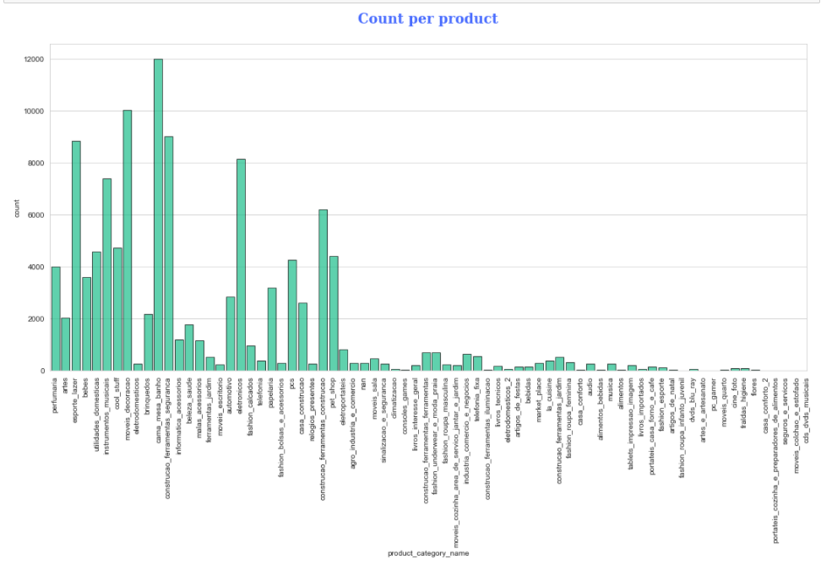
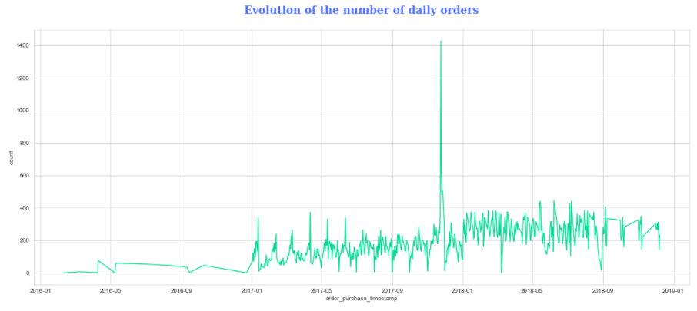
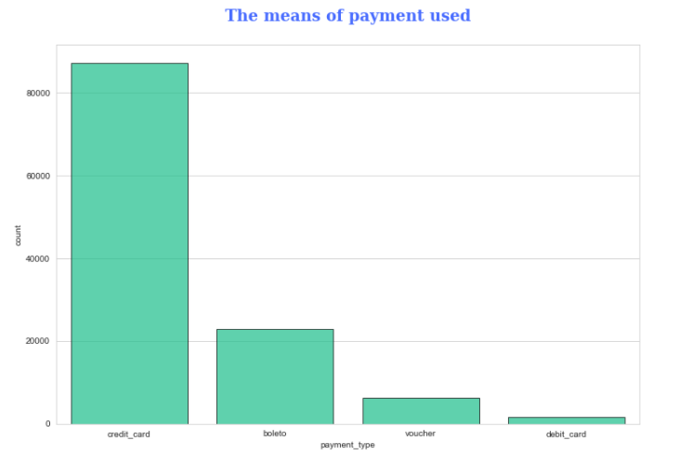
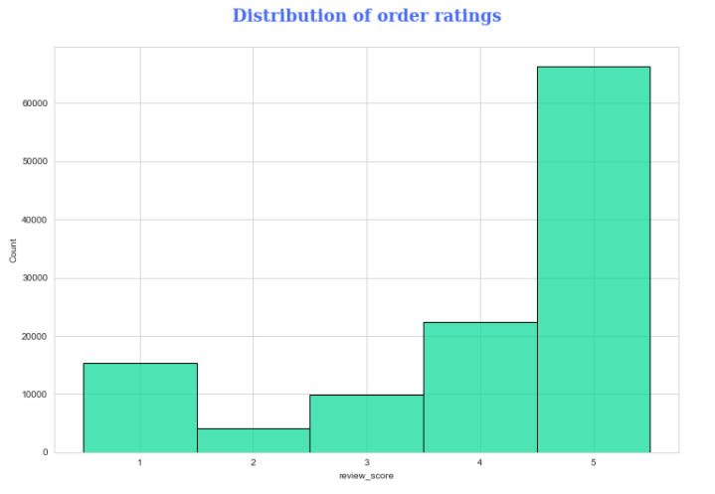
EDA

Slide 11
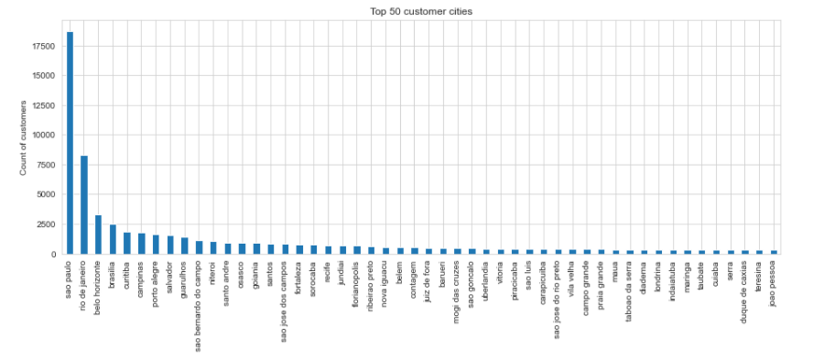
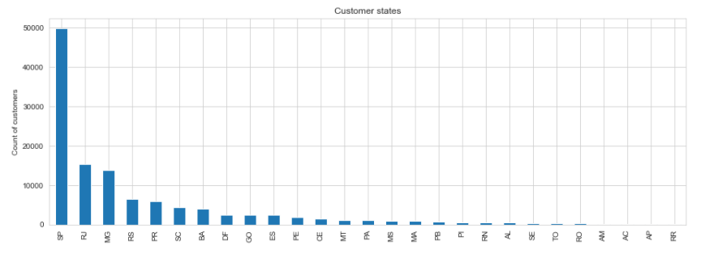
EDA

Slide 12
Data Preparation
Checking Null Values
Checking the null values in the data-frame
Handling null values
For continuous variable it was filled by median() as there were few outliers within required columns and as for non-numeric, they were handled by filling mode()
Treating non-numeric values
All the unique values were checked for states and merged into regions

Slide 13



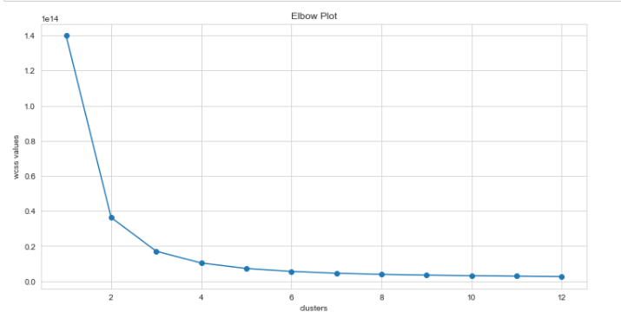
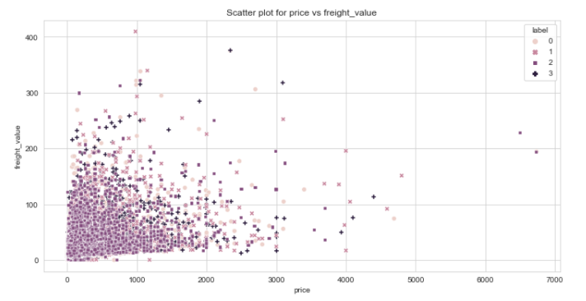
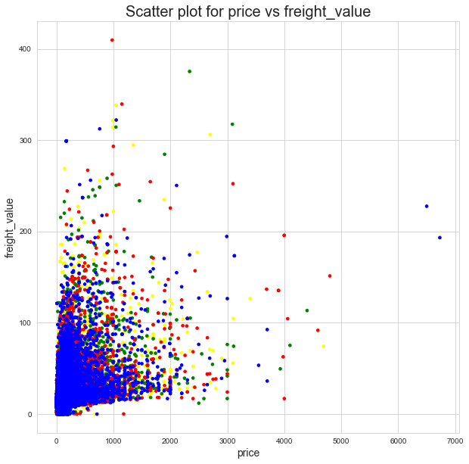
K-Means Model
Elbow plot/WCSS​
K-means fit
Plot​
Since there was no pattern after 4 we took cluster=4
Creating the model and plotting clusters for any 2 values with training clusters
Plotting resulting clusters. ​

Slide 14
RfM
RFM is a method used for analyzing customer value. It is commonly used in database marketing and direct marketing and has received particular attention in retail and professional services industries.
Recency
Recency is Days since last order
Recency(i) =Reference date (last day in dataset) — Date of last order(i)
frequency
Number of total order
Frequency(i) = Count(orders)(i)
Monetary
Amount of total purchase value
Sum(purchase order values)(i)

Slide 15
RFM Segmentation on recency
The timeline of the data was split into four main segments. Each segment is 1/4 of the total time span of the data. We have defined the following Recency-segments:
INACTIVE
COLD
HOT
ACTIVE
Recency(i) ≥ Third quartile (Q3) of total Time period
Recency(i) ≥ Second quartile (Q2) of total Time period < Third quartile (Q3) of total Time period
Recency(i) ≥ First quartile (Q1) of total Time period < Second quartile (Q2) of total Time period
Recency(i) < First quartile (Q1) of total Time period

Slide 16
RFm SUB-Segmentation
In a second step the total purchase amount of a customer was sorted to either, higher than the median total purchase amount or lower. Doing so produces two classes:
Low
High
The two classes were combined for each customer to a sub-segment. The distribution can be made visible in a tree map or waffle chart.

Slide 17
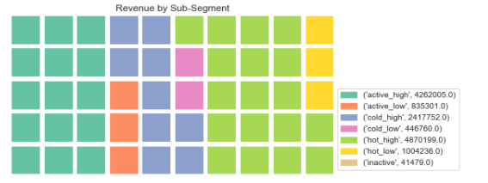
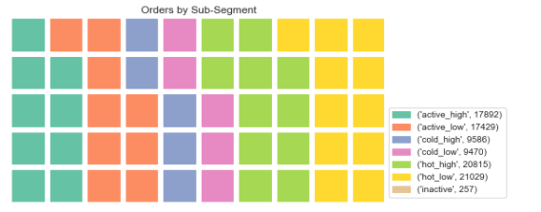
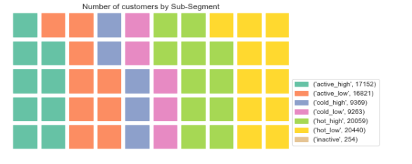
Waffle charts for sub-segmentation

Slide 18
Rfm analysis-
The RFM analysis is another way to segment customers in order to develop marketing strategies. The three used metrics Recency, Frequency and Monetary lead to a combined individual classification. With this classification also an appropriate proposed marketing strategy will be developed. The number of the sub-segments which is created in this process is arbitrary and might not be in line with an underlying clustering as it appears in the data.
In step one of the RFM segment process each of the labels Recency, Frequency and Monetary is individually calculated per customer. In step two, two metrics are developed:
RFM score: A calculated value with is the product of the three scores (R-score * F-score * M-score)
RFM segment label: A number code with is created by combining the three scores in a row (R-score , F-score & M-score) In step three filter conditions based on the two metrics for customer types are defined. The segmentation process in this analysis is dealing with 7 customer types:
Best Customer
Big Spender
Loyalist
Potential Loyalist
Hibernating
Almost Lost
Lost Customer

Slide 19
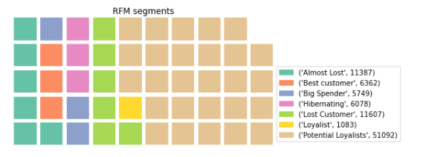
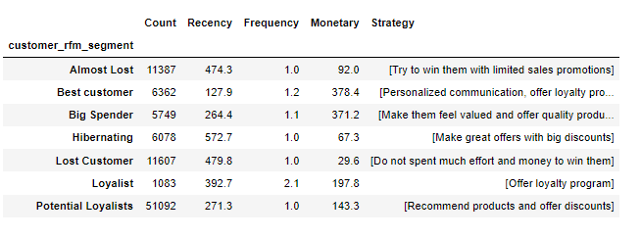
RfM analysis
Based on the observed customer behaviour the appropriate marketing strategy added to a summarized list

Slide 20
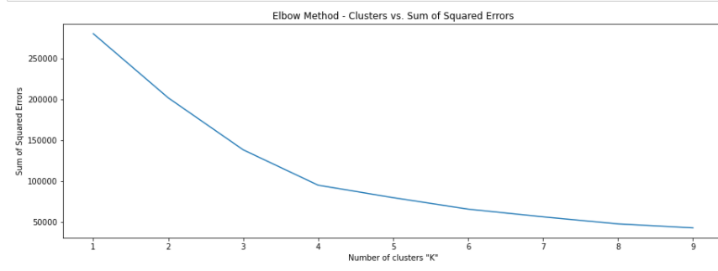
K-means on rfm analysis
Evaluation of the applied RFM segmentation by comparison with ML clustering method.
Sklearn K-means algorithm is applied to find underlying segments that are different from the arbitrarily chosen RFM classes to provide a different angle of view and confidence level on the above performed segmentation.
Using elbow method, we got number of cluster=4. When K-Means is applied for 4 clusters we can see where the borders were defined.

Slide 21
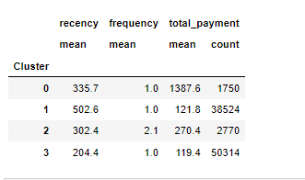
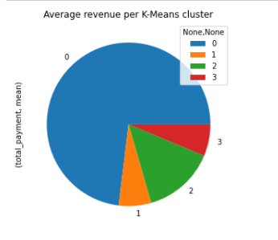
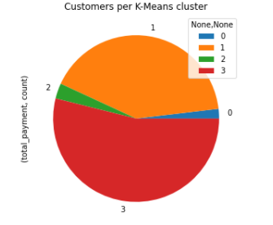
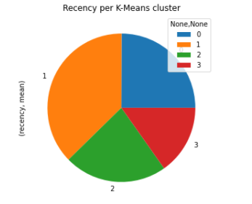
summary table and the pie charts below visualize the new clustering
The above scatter plot visualizes how K-Means clusters the data into four segments.
Group 0: Early Customers with low purchase value
Group 1: Loyal Customers
Group 2: Hibernating Customers with low purchase value
Group 3: Big Spenders

Slide 22
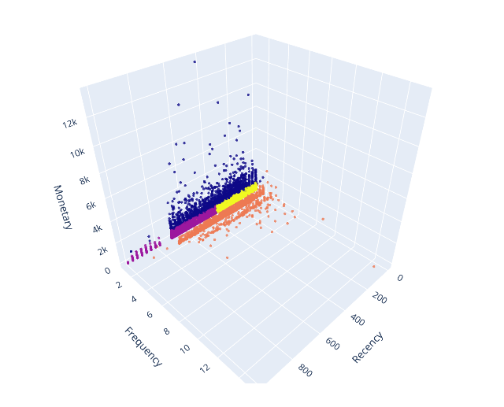
Scatter plot of k-means
The relation of these clusters to each other can be visualized in the 3D scatter plot.

Slide 23
conclusion-
Conclusion based on RFM segmentation & sub-segmentation:
The strongest class of the 7 generated sub-segments is active customers with high spending, followed by "hot" customers which high spending, which is a good sign for the business.
Active customers with high and low spending placed the most orders, followed by "hot" customers.
Active customers are also the biggest groups in terms of head count.
Inactive customers represent in each chart the smallest proportion.
Conclusion based on RFM rank and score:
The order frequency and order amounts are concentrated on the lower end.
The biggest RFM segment is the group of Potential Loyalists. These are customers that need to be targeted with offers and discounts in order to make the business successful.
There is a good base of Best Customers, which is good news for the business.
Some effort needs to be spent to target hibernating customers and customers which are almost lost

Slide 24
summary
Along with the segmentation of customers a table with marketing strategies is available. The recommendations in this table also need to be seen in the light of the segment's importance for the business. As shown , "High Spenders" and the big group of "Potential Loyalists" (or "New Low-Spenders") have a high importance. Their marketing strategy has therefore a higher priority.

Slide 25
What’s next?
The analysis in this part of the project is a reflection of how consumers react to what and how business is offering. After seeing demographic background, it is now important to also understand which improvements would enhance satisfaction and increase consumer attraction. This could be the one of the key objectives of the business case analysis and would be the logical next step. The objective can be archived by analysing data from the customer satisfaction reports if provided and also finding a way to recommend products in an effective way.

Slide 26
Thank you
SANA JALGAONKAR​​
sanajalgaonkar2810.sj@gmail.com​

